Slide 1
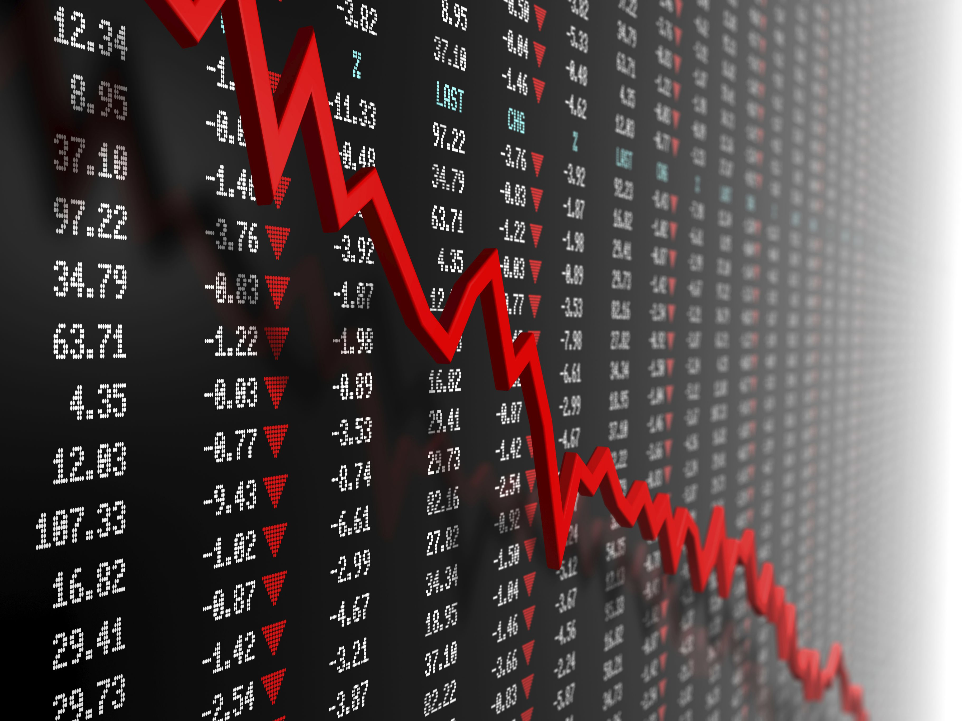

STOCK PRICE TREND ANALYSIS: UNCOVERING PATTERNS AND INSIGHTS
PREPARED by
JOSEPHINE AKUBILLA
SUPERVISOR: Dr. smruti mehta

Slide 2

TABLE OF CONTENT
Introduction
Objective
Descriptive Statistics
Time Series Analysis
Linear Regression
Summary
Appendix

Slide 3
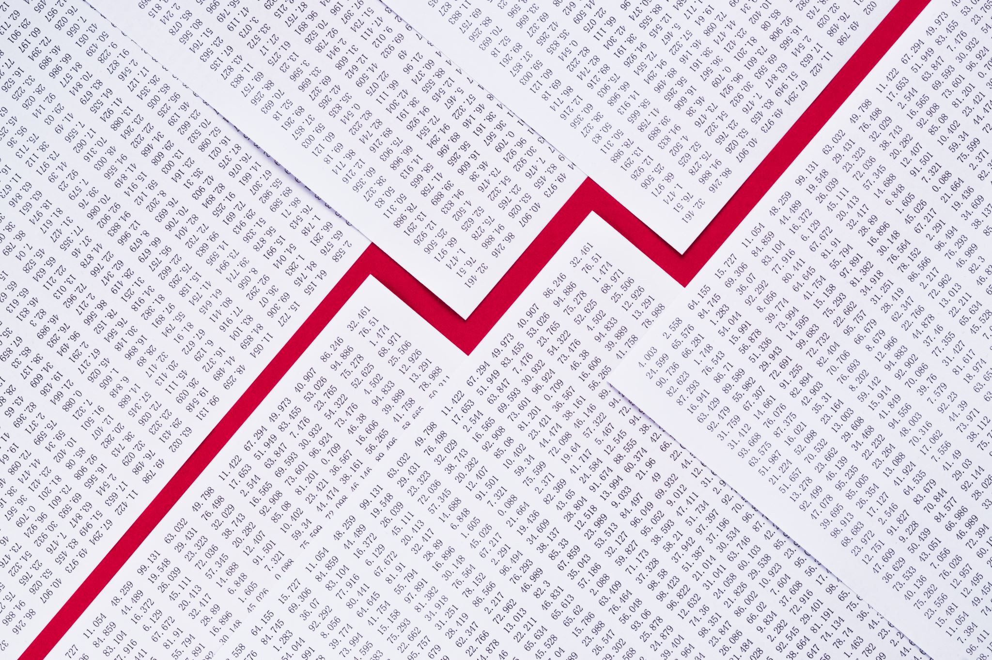
Introduction
The stock price is a representation of the market's assessment of the value of a company. It is influenced by various factors, including the company's financial performance, growth prospects, industry conditions, and overall economic trends.
Understanding stock prices trend is important for making informed decisions related to investment, risk management, and strategic planning
This dataset is extracted from the Website of Yahoo Finance and spans from 2018 to 2023.
Data Set comprises of live data stock values of 3 major companies: Microsoft, Apple and Tesla as well as S&P 500(a primary stock market index )values during the same time frame

Slide 4

OBJECTIVES
The main goal is to conduct an in-depth statistical analysis of the stock prices of major US companies, specifically Microsoft, Apple and Tesla, covering the period from 2018 to 2023. This entails creating comparative descriptive statistics and visually engaging charts, including scatter plots and histograms, to depict and explain the trends in the price values of each stock throughout the specified duration. The objective of the statistical report is to provide a nuanced comprehension of the dynamic behaviors exhibited by company stocks, utilizing metrics such as mean, median, and deviation. Through the collection of real-time data, the analysis aims to deliver valuable insights into the changing patterns and fluctuations in stock prices, supporting informed decision-making and strategic planning in the realms of investment and financial analysis.
4

Slide 5
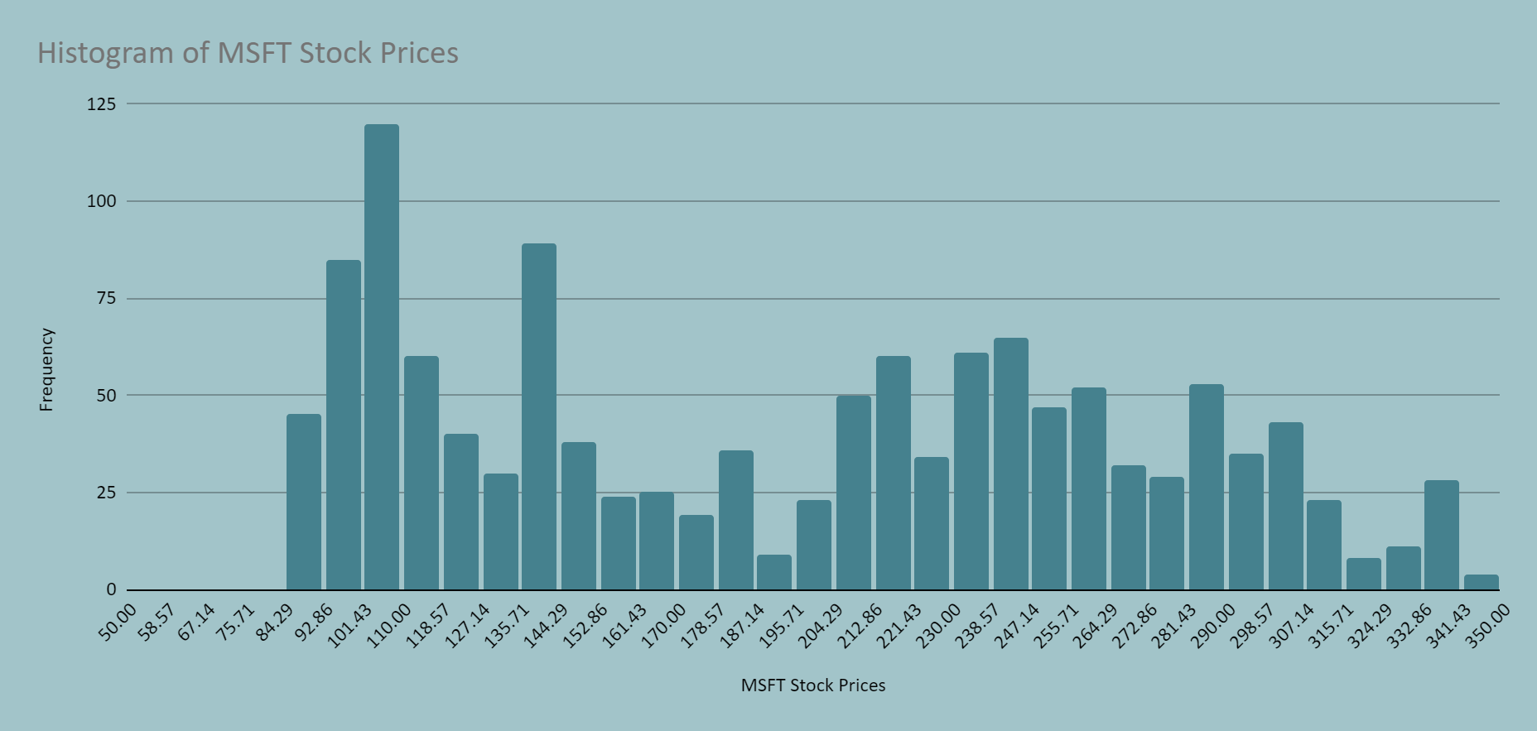
DESCRIPTIVE STATISTICS
MICROSOFT
Mean | 194.471
Median | 203.580
Mode | 95.140
Minimum | 86.060
Maximum | 344.620
Sum | 248533.810
Count | 1278.000
Range | 258.560
Variance | 5510.449
Standard Deviation | 74.232
Skewness | 0.150
Kurtosis | -1.288
Standard Error | 2.076
Table 1
Figure 1
The descriptive statistics reveal key characteristics of a dataset with 1,278 observations. The central tendency is represented by the mean (194.471), median (203.580), and mode (95.140). The dataset exhibits a range from a minimum value of 86.060 to a maximum of 344.620, resulting in a range of 258.560. The dispersion of the data is quantified by the variance (5510.449) and standard deviation (74.232). The distribution displays a slight positive skewness (0.150), indicating a longer tail on the right side, while the negative kurtosis (-1.288) suggests a distribution with lighter tails and a flatter peak than a normal distribution. The standard error is reported at 2.076, providing an estimate of the standard deviation of the sample mean. These statistics collectively offer a comprehensive summary of the dataset's central tendency, spread, and shape.

Slide 6
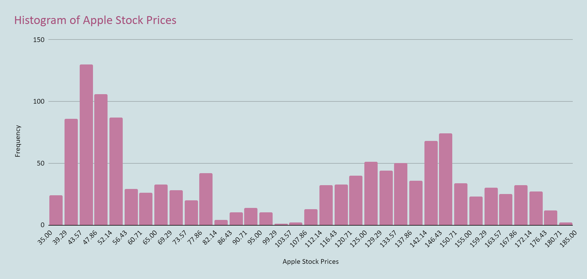
DESCRIPTIVE STATISTICS
APPLE
Mean | 98.574
Median | 95.087
Mode | 127.820
Minimum | 35.995
Maximum | 182.630
Sum | 125977.705
Count | 1278.000
Range | 146.635
Variance | 2132.236
Standard Deviation | 46.176
Skewness | 0.122
Kurtosis | -1.582
Standard Error | 1.292
Table 2
Figure 2
The descriptive statistics for Apple stock, based on 1,278 data points, provide a thorough understanding of its numerical properties. Central tendency measures, including a mean of 98.574, a median of 95.087, and a mode of 127.820, depict the typical values. The stock's range spans from a minimum of 35.995 to a maximum of 182.630, indicating a total range of 146.635. Variability is evident in a variance of 2132.236 and a standard deviation of 46.176. A skewness of 0.122 suggests a minor asymmetry in the distribution, while a kurtosis of -1.582 indicates lighter tails and a flatter peak compared to a normal distribution. The standard error, reported at 1.292, offers an approximation of the standard deviation of the sample mean. These statistics collectively furnish a comprehensive overview of Apple stock, encompassing central tendency, variability, and distribution characteristics.

Slide 7
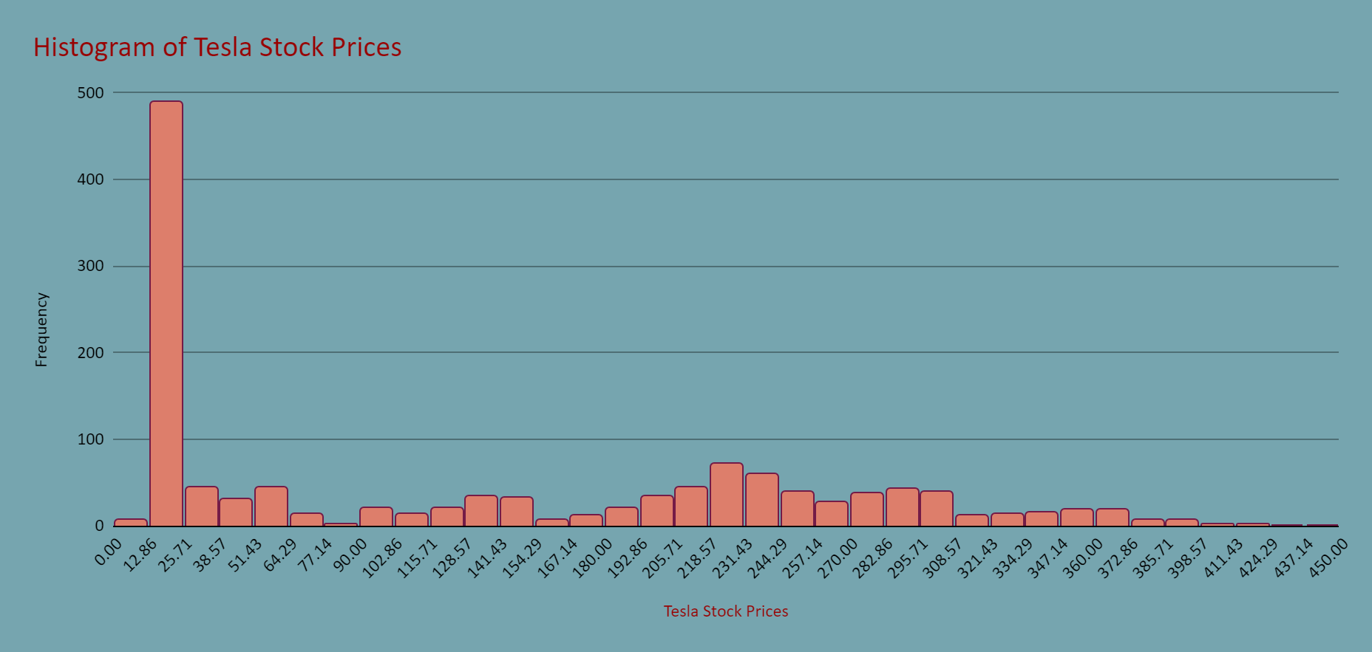
DESCRIPTIVE STATISTICS
TESLA
Mean | 131.895
Median | 96.573
Mode | 24.000
Minimum | 12.073
Maximum | 411.470
Sum | 168562.080
Count | 1278.000
Range | 399.397
Variance | 13728.007
Standard Deviation | 117.167
Skewness | 0.471
Kurtosis | -1.257
Standard Error | 3.277
Table 3
Figure 3
The statistical summary for Tesla stock, derived from 1,278 data points, provides valuable information about its numerical characteristics. Measures of central tendency include a mean of 131.895, a median of 96.573, and a mode of 24.000. The stock demonstrates a wide range, extending from a minimum value of 12.073 to a maximum of 411.470, resulting in a span of 399.397. The variability in the dataset is captured by a variance of 13728.007 and a standard deviation of 117.167. A positive skewness of 0.471 indicates a slight asymmetry with a longer tail on the right side. The kurtosis of -1.257 suggests a distribution with lighter tails and a flatter peak compared to a normal distribution. The standard error is noted at 3.277, providing an approximation of the standard deviation of the sample mean. Collectively, these statistics offer a comprehensive overview of Tesla stock, encompassing its central tendency, variability, and distribution shape.

Slide 8
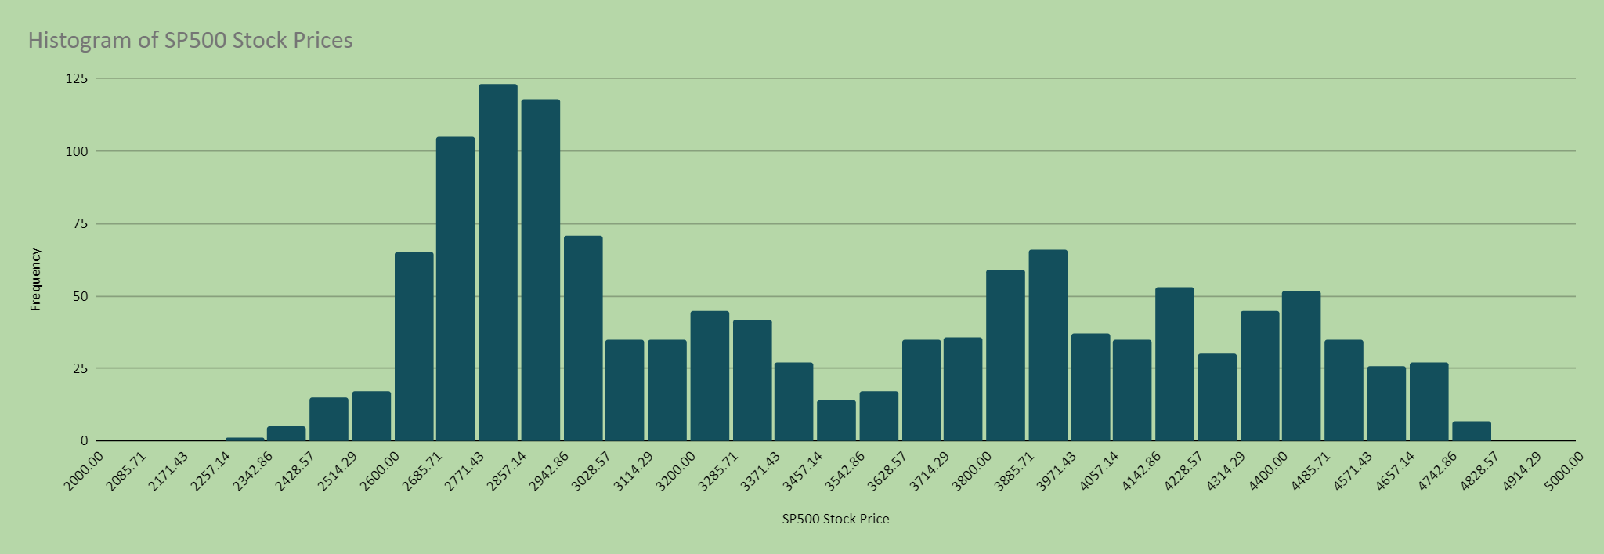
DESCRIPTIVE STATISTICS
S&P 500
Mean | 131.895
Median | 96.573
Mode | 24.000
Minimum | 12.073
Maximum | 411.470
Sum | 168562.080
Count | 1278.000
Range | 399.397
Variance | 13728.007
Standard Deviation | 117.167
Skewness | 0.471
Kurtosis | -1.257
Standard Error | 3.277
Table 4
Figure 4
The descriptive statistics for the S&P 500, drawn from 1,278 data points, present a thorough summary of its numerical features. Key indicators of central tendency, such as a mean of 3457.034, a median of 3294.670, and a mode of 2832.410, offer understanding into the typical values within the stock index. The range of the index extends from a minimum of 2290.710 to a maximum of 4804.510, resulting in a span of 2513.800. Variability is evident through a variance of 444300.942 and a standard deviation of 666.559. A skewness of 0.333 points to a slight asymmetry in the distribution, while a kurtosis of -1.297 suggests lighter tails and a flatter peak compared to a normal distribution. The standard error, reported at 18.645, provides an estimate of the standard deviation of the sample mean. In combination, these statistics offer a comprehensive understanding of the S&P 500's central tendency, variability, and distribution characteristics.

Slide 9
AVERAGE OF S&P 500 STOCK PRICE POINTS FROM 2018 TO 2023
Year | Open | Low | High | Close | Adj Close | Volume | SP%chng
2018 | 2747.9107 | 2730.2841 | 693423.9400 | 2746.2142 | 2746.2142 | 3634742988.0478 | -0.0002
2019 | 2911.6276 | 2899.4399 | 736752.8300 | 2913.3564 | 2913.3564 | 3558549642.8571 | 0.0010
2020 | 3217.7503 | 3190.4845 | 820272.5400 | 3217.8558 | 3217.8558 | 4922448418.9723 | 0.0007
2021 | 4271.1707 | 4251.0427 | 1081553.1500 | 4273.3856 | 4273.3856 | 4417139920.6349 | 0.0010
2022 | 4100.6265 | 4060.9469 | 1037817.9100 | 4098.5147 | 4098.5147 | 4617723067.7291 | -0.0008
2023 | 3944.7758 | 3920.3237 | 75567.5900 | 3954.5542 | 3954.5542 | 4004446842.1053 | 0.0030
Grand Total | 3457.0341 | 3433.6458 | 4445387.9600 | 3457.2301 | 3457.2301 | 4227470023.4742 | 0.0004
Table 5
Throughout the six-year span spanning 2018 to 2023, the S&P 500 index showcased diverse patterns in its opening, lowest, highest, closing, adjusted closing values, and trading volume. In the initial year, 2018, the index initiated at 2747.91, touched a low of 2730.28, peaked at 693423.94, and concluded at 2746.21. The adjusted close and trading volume were similarly documented at 2746.21 and 3634742988.05, respectively, with an unvaried percentage change of 0.00%. Successive years witnessed fluctuations in these metrics, with notable shifts in 2020 when the S&P 500 commenced at 3217.75, marked a low at 3190.48, and reached a zenith at 820272.54. The adjusted close and trading volume for that specific year were 3217.86 and 4922448418.97, correspondingly, with a percentage change of 0.0007148379839. In 2023, the index recorded an opening at 3944.78, a low at 3920.32, and an unusual peak at 75567.59, closing at 3954.55. The adjusted close and trading volume were documented at 3954.55 and 4004446842.11, featuring a conspicuous percentage change of 0.002997521728. The cumulative values of these metrics over the entire period, highlighted in the grand total, furnish a holistic portrayal of the S&P 500's performance throughout this timeframe.

Slide 10
AVERAGE OF TESLA STOCK PRICE POINTS FROM 2018 TO 2023
Year | Open | Low | High | Close | Adj Close | Volume | Tesl%chng
2018 | 21.1456 | 20.7035 | 21.5796 | 21.1540 | 21.1540 | 129181601.5936 | 0.0010
2019 | 18.2019 | 17.9075 | 18.5100 | 18.2353 | 18.2353 | 137383833.3333 | 0.0012
2020 | 96.3695 | 93.5660 | 99.0961 | 96.6657 | 96.6657 | 225923862.4506 | 0.0105
2021 | 259.9464 | 254.2360 | 265.2439 | 259.9982 | 259.9982 | 82174886.9048 | 0.0023
2022 | 264.1352 | 256.5074 | 270.5677 | 263.0931 | 263.0931 | 86934449.4024 | -0.0034
2023 | 130.6184 | 126.6226 | 135.2926 | 132.1421 | 132.1421 | 194632294.7368 | 0.0230
Grand Total | 131.8952 | 128.5118 | 134.9584 | 131.7903 | 131.7903 | 133357337.3239 | 0.0026
Table 6
Over the six-year period from 2018 to 2023, Tesla's stock exhibited varying trends in its opening, lowest, highest, closing, adjusted closing values, and trading volume. In 2018, the stock opened at 21.1456, reached a low of 20.7035, and achieved a high of 21.5796, closing at 21.1540. The adjusted close and trading volume were also reported at 21.1540 and 129181601.5936, respectively, with a percentage change of 0.0010. Subsequent years saw fluctuations in these parameters, with notable changes in 2020 when Tesla's stock opened at 96.3695, marked a low at 93.5660, and reached a high at 99.0961. The adjusted close and trading volume for that specific year were 96.6657 and 225923862.4506, respectively, with a percentage change of 0.0105. In 2023, the stock recorded an opening at 130.6184, a low at 126.6226, and a high at 135.2926, closing at 132.1421. The adjusted close and trading volume were documented at 132.1421 and 194632294.7368, featuring a notable percentage change of 0.0230. The grand total for the entire period, highlighted in the summary, provides a cumulative overview of Tesla's stock performance, encompassing central tendency, variability, and trading activity during this timeframe.

Slide 11
AVERAGE OF Microsoft STOCK PRICE POINTS FROM 2018 TO 2023
Year | Open | Low | High | Close | Adj Close | Volume | MS%chng
2018 | 101.1224 | 99.9193 | 102.1141 | 101.0340 | 96.0221 | 31590188.8446 | 0.0008
2019 | 130.3390 | 129.3038 | 131.2310 | 130.3820 | 125.9355 | 24580994.0476 | 0.0018
2020 | 192.9102 | 190.3774 | 195.4651 | 193.0261 | 188.7168 | 37659592.4901 | 0.0016
2021 | 275.6678 | 273.4390 | 278.0180 | 275.9408 | 272.3931 | 26013012.6984 | 0.0018
2022 | 269.1050 | 265.2897 | 272.4961 | 268.9171 | 267.5424 | 31219290.8367 | -0.0012
2023 | 236.1437 | 233.5589 | 239.2321 | 236.7268 | 236.7268 | 33657310.5263 | 0.0016
Grand Total | 194.4709 | 192.3018 | 196.5227 | 194.5105 | 190.8268 | 30267789.4366 | 0.0010
Table 7
Throughout the six-year span from 2018 to 2023, Microsoft's (MSFT) stock demonstrated varied patterns in its opening, lowest, highest, closing, adjusted closing values, and trading volume. In 2018, the stock initiated at 101.1223509, reaching a low of 99.91928312 and a high of 102.1140637, closing at 101.0339841. The adjusted close and trading volume were also indicated at 96.02207146 and 31590188.84, respectively, with a percentage change of 0.0007966836205. Subsequent years experienced fluctuations in these metrics, notably in 2020 when MSFT stock opened at 192.9102371, registered a low at 190.3774308, and attained a high at 195.4651384. The adjusted close and trading volume for that particular year were 188.716793 and 37659592.49, respectively, with a percentage change of 0.001646330481. In 2023, the stock's opening was 236.1436833, with a low at 233.5589464 and a high at 239.2321055, closing at 236.7268421. The adjusted close and trading volume were documented at 236.7268421 and 33657310.53, featuring a noteworthy percentage change of 0.001626418765. The comprehensive summary of the entire period provides an accumulated perspective on MSFT stock performance, covering central tendency, variability, and trading activity over this timeframe.
11

Slide 12
AVERAGE OF APPLE STOCK PRICE POINTS FROM 2018 TO 2023
Year | Open | Low | High | Close | Adj Close | Volume | App%chng
2018 | 47.2779 | 46.7959 | 47.7485 | 47.2634 | 45.3122 | 136080258.1673 | -0.0001
2019 | 51.9673 | 51.5679 | 52.4579 | 52.0640 | 50.7024 | 112122788.8889 | 0.0025
2020 | 95.2677 | 93.9128 | 96.6618 | 95.3471 | 93.9164 | 157564646.6403 | 0.0029
2021 | 140.8619 | 139.4741 | 142.3478 | 140.9894 | 139.8008 | 90524627.3810 | 0.0013
2022 | 154.8027 | 152.6913 | 156.9078 | 154.8351 | 154.3819 | 87910083.2669 | -0.0010
2023 | 134.7274 | 133.2874 | 136.8995 | 135.3311 | 135.3311 | 72488215.7895 | 0.0065
Grand Total | 98.5741 | 97.4227 | 99.7780 | 98.6465 | 97.3882 | 116220544.8357 | 0.0012
Table 8
Over the span of six years, from 2018 to 2023, Apple's stock (AAPL) displayed various trends in its opening, lowest, highest, closing, adjusted closing values, and trading volume. In 2018, the stock began at 47.2779, with a low of 46.7959 and a high of 47.7485, closing at 47.2634. The adjusted close and trading volume were also reported at 45.3122 and 136080258.1673, respectively, with a percentage change of -0.0001. Subsequent years witnessed fluctuations in these metrics, notably in 2020 when AAPL stock opened at 95.2677, reached a low of 93.9128, and achieved a high at 96.6618. The adjusted close and trading volume for that specific year were 93.9164 and 157564646.6403, respectively, with a percentage change of 0.0029. In 2023, the stock recorded an opening at 134.7274, a low at 133.2874, and a high at 136.8995, closing at 135.3311. The adjusted close and trading volume were documented at 135.3311 and 72488215.7895, featuring a notable percentage change of 0.0065. The grand total for the entire period, highlighted in the summary, provides a cumulative overview of AAPL stock performance, encompassing central tendency, variability, and trading activity during this timeframe.

Slide 13
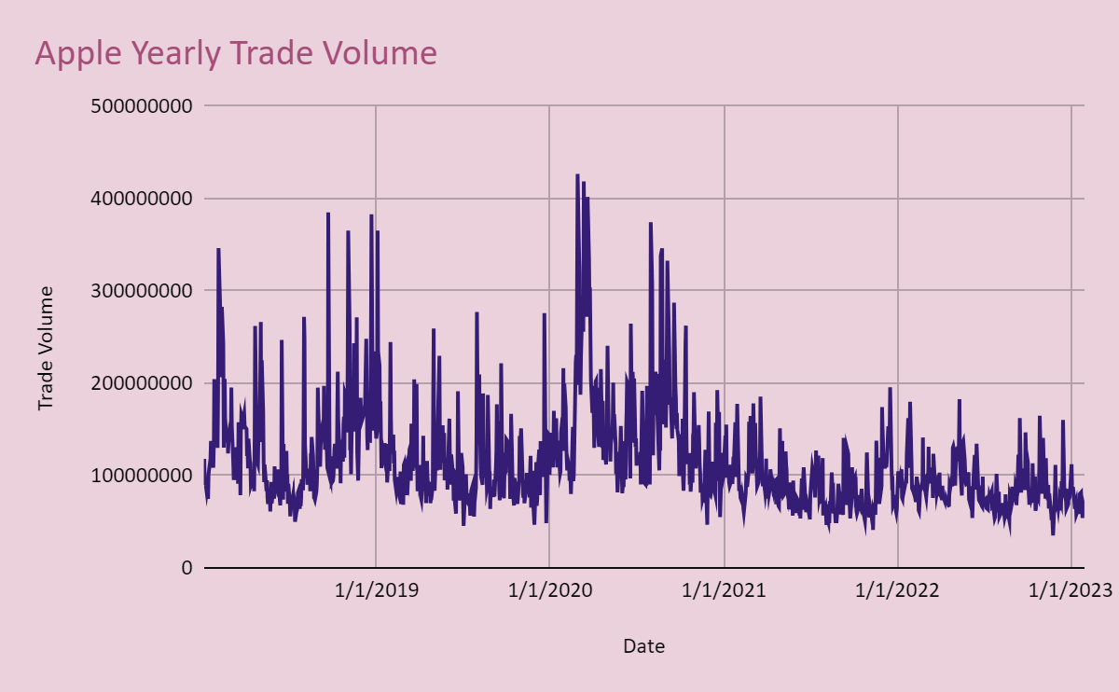
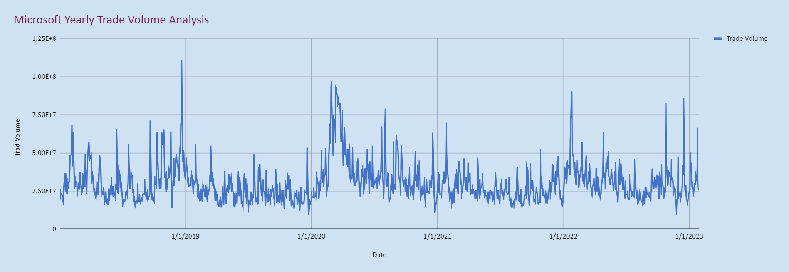
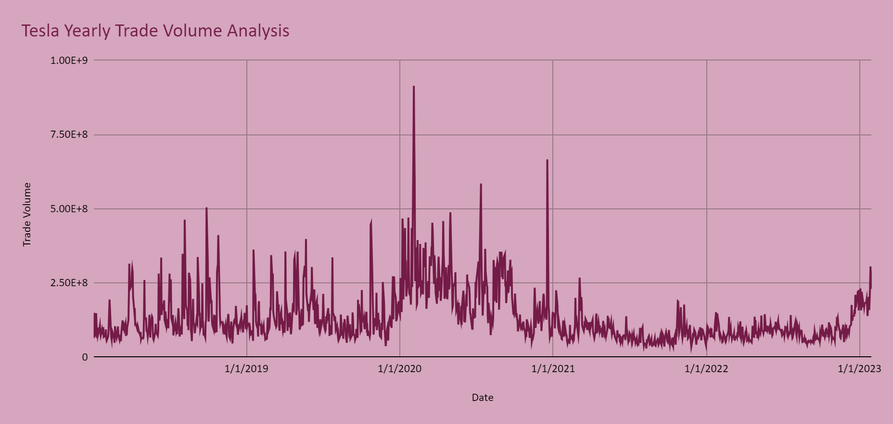
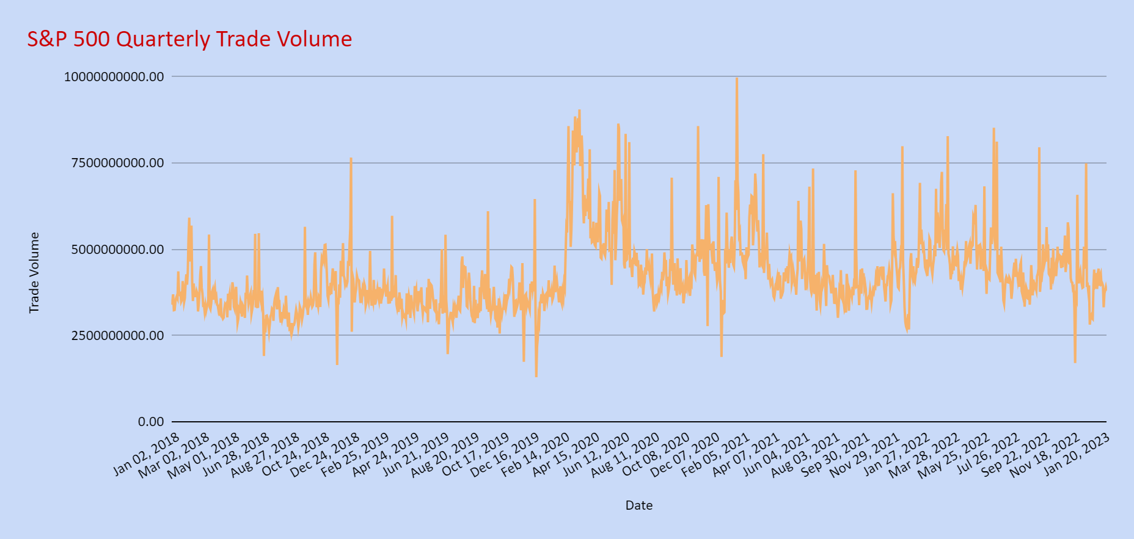
Trade Volume analysis
Figure 5
Figure 6
Figure 7
Figure 8

Slide 14
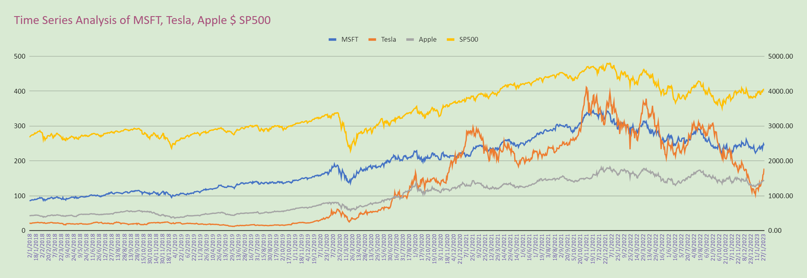
Time Series Analysis
Figure 9
All stock prices listed here follows a positive continual trend indicating a spike in stock prices over the years. Tesla’s stock prices are lowest in 2018 followed by Apple. However, Tesla’s stock price increases in 2020 surpassing Apple in 2020 and surpassing Microsoft which is the highest of the three in 2021. The increase in Tesla’s stock prices could be attributed to its inclusion in the S&P 500 which led to an increased demand for its shares from institutional investors and index funds. This inclusion heightened Tesla's visibility and credibility in the financial markets, attracting more investors. Another crucial factor is the anticipation and realization of increased demand for electric vehicles. Tesla's leadership in the EV market, combined with growing global awareness and support for sustainable and clean energy solutions, contributed to the surge in its stock price. Teslas’s stock price declines significantly in 2022. Shares sank about 65% from the start of the year, amounting to a loss of more than $700 billion in market value. According to Craig Irwin, an analyst at Roth Capital Partners, most of the stock’s weakness in 2022 is due to indicators showing flagging demand globally.
All stock prices experience a sharp decline in 2020 due to the Covid 19 epidemic and in 2022 due to higher inflation, expectations of tighter monetary policy from Federal Reserve and a serious spike in bond yields.

Slide 15
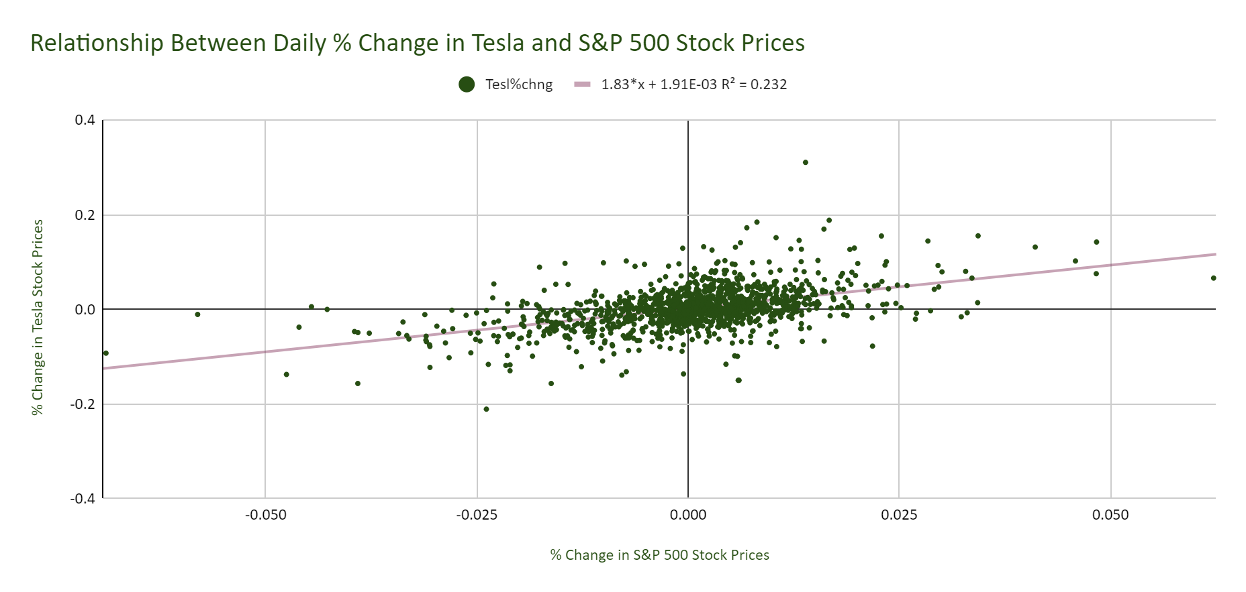
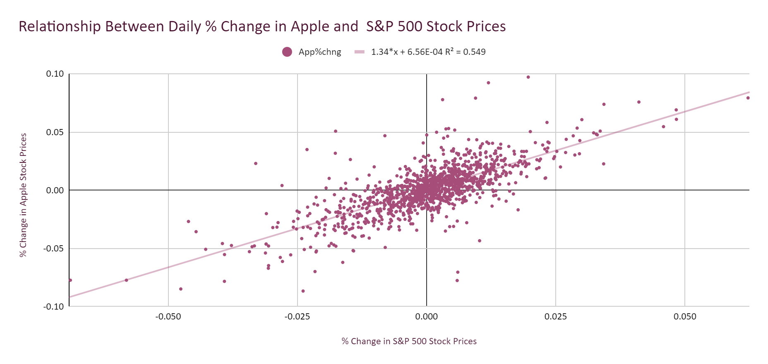
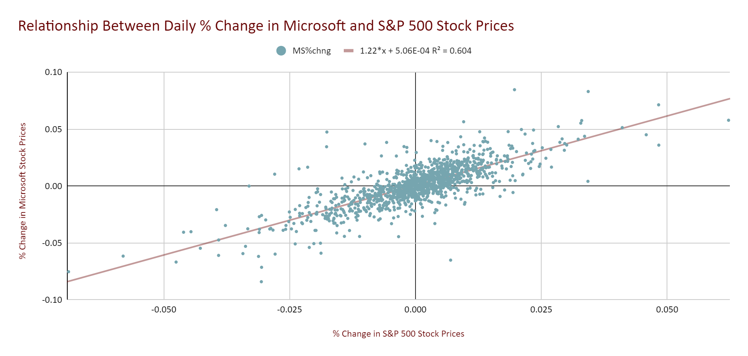
A simple linear regression
Figure 10
Figure 11
Figure 12
An R value of 0.4814 suggests a mild positive correlation between the returns of Tesla and S&P 500. The corresponding R squared value of 0.232 indicates that approximately 23.2% of the variability in Tesla's returns can be accounted for by the explanatory variable, S&P 500. Tesla exhibits a high beta of 1.832, indicating a considerable level of volatility in comparison to the broader market.
An R value of 0.741 signifies a robust positive correlation between the returns of Apple and S&P 500. With an R squared value of 0.549, approximately 54.9% of the variability in Apple's returns can be attributed to the explanatory variable, S&P 500. Apple displays a high beta of 1.338, indicating notable volatility in comparison to the broader market.
An R squared value of 0.778 signifies a robust positive correlation between the returns of Microsoft and S&P 500. With an R squared value of 0.604, approximately 60.4% of the variability in Microsoft's returns can be attributed to the explanatory variable, S&P 500. Microsoft exhibits a high beta of 1.222, indicating notable volatility compared to the broader market.

Slide 16
SUMMARY
Microsoft is deemed a stable choice for risk-averse investors due to its low beta and moderate correlation, aligning well with broader market trends. The company's stock is perceived as a reliable option for those prioritizing stability in their investment portfolios. On the other hand, Apple, with a substantial correlation and a balanced risk-return profile, offers a middle ground. This makes it an attractive option for investors seeking market alignment along with a degree of stability. In contrast, Tesla, characterized by a high beta and weak correlation, is considered riskier. While it presents significant growth potential, its volatility makes it less aligned with broader market trends.
For long-term investors looking for a combination of stability and balanced growth, Microsoft or Apple may be preferable choices. Microsoft, with its stability, or Apple, with its balanced risk-return profile, could provide consistent returns over an extended period. For short-term traders aiming for higher profit potential, Tesla becomes an appealing option due to its volatility, which can lead to more significant short-term gains. Diversification is also emphasized as a strategy for investors with varying risk tolerances, providing a means to achieve financial stability and growth prospects by spreading investments across different assets and sectors.
16

Slide 17

APPENDIX

Slide 18

GLOSSARY
Date: The Specific Day on which the Stock is recorded
Open : The price of the stock at the beginning of the trading day
High: The Highest price of the stock during the trading day
Close Price: The price of the stock at the end of the trading day
Adjusted Close Price: The closing price adjusted for any corporate actions (e.g., dividends, stock splits)
Volume: The number of shares traded during the day
Percentage Change(%chng): The percentage change in the stock’s price from the previous trading day.
S&P 500: a market-capitalization-weighted index that measures the performance of 500 large-cap stocks listed on stock exchanges in the United States

Slide 19
LIST OF TABLES AND FIGURES
Table 1 Descriptive Statistics( Microsoft)…………………………………………………………………………………………………………………………………….
Table 2 Descriptive Statistics( Apple)……………………………………………………………………………………………………………………………………......
Table 3 Descriptive Statistics( Tesla)………………………………………………………………………………………………………………………………………....
Table 4 Descriptive Statistics(S&P 500)………………………………………………………………………………………………………………………………………
Figure 1 Histogram showing the distribution of Microsoft Stock Prices………………………………………………………………………………………….................
Figure 2 Histogram showing the distribution of Apple Prices…………………………………………………………………………………………………………....
Figure 3 Histogram showing the distribution of Tesla Stock Prices………………………………………………………………………………………………………
Figure 4 Histogram showing the distribution of S&P 500 Stock Prices………………………………………………………………………………………………..........
Table 5 Table Showing the Average of S&P 500 Stock Prices From 2018 to 2023 ……………………………………………………………………………………….
Table 6 Table Showing the Average of Microsoft Stock Prices From 2018 to 2023 ……………………………………………………………………….........................
Table 7 Table Showing the Average of Tesla Stock Prices From 2018 to 2023 ……………………………………………………………………………………….
Table 8 Table Showing the Average of Apple 500 Stock Prices From 2018 to 2023……………………………………………………………………………………….
Figure 5 Volume Bar Chart Showing Yearly Trade Volume Analysis of Apple ………………………………………………………………………………………….....
Figure 6 Volume Bar Chart Showing Yearly Trade Volume Analysis of Microsoft ……………..………………………………………………………………………………
Figure 7 Volume Bar Chart Showing Yearly Trade Volume Analysis of Tesla ……………………………………………………………………………………………
Figure 8 Volume Bar Chart Showing Yearly Trade Volume Analysis of S&P 500 …………………………………………………………………………………………….
Figure 9 Line Chart Showing Time Series Analysis of Apple, Microsoft, Tesla, and S&P 500…………………………………………………………………....................
Figure 10 Scatter Plot Showing the Relationship Between % Change in Microsoft and S&P 500 …………………………………………………………………………….
Figure 11 Scatter Plot Showing the Relationship Between % Change in Microsoft and S&P 500………………………………………………….........................................
Figure 12 Scatter Plot Showing the Relationship Between % Change in Microsoft and S&P 500 ………………………………………………………………………….

Slide 20
THANK YOU

